Slide 1
Window of Uncertainty
Ahmad Byagowi

Slide 2
Motivation
Distributed applications may require to know the time sync error bound in order adjust their performance accordingly.
Linearizability as a requirement
Parallel to serial pipelines
One way latency
Precision Time Based Scheduling and Routing
Realtime Indication of Precision Time Sync System Performance
Precision Time Sync [components] Fault Detection

Slide 3
Overview
PTP delivers time to the end nodes from the Time Server [aka GM]
End nodes need to estimate/predict the error bound
Time Server provides the end nodes with the error bound of its service
Error bound can be separated in two parts; precision and accuracy
Precision is based on the offset variance perceived by the end node
Accuracy is based on the agreement with other peers

Slide 4
Quick Reminder on Precision vs. Accuracy
Reference
Not Accurate
Not Precise
Accurate
Not Precise
Not Accurate
Precise
Accurate
Precise

Slide 5
Formulation
Clock synchronization requires processes (p_{1,} p_{2,} p_{3,} … p_{n}) to bring their clocks as close as possible together by using communication between them.
For process p_{i}, the adjusted clock of a process p_{i} AC(t)_{i} is a function of the hardware clock HC(t)_{i} and a variable adj_{i}
The synchronization process in p_{i} adjusts the value of adj_{i} and thus changes the value of AC(t)_{i}
Error bound of γ is defined by achieving |AC(t)_{i}-AC(t)_{j}| ≤ γ for any given i and j representing processes p_{i} and p_{j}
For every p_{i} participating in clock synchronization, γ is at least ε(1-1/n) where ε is the uncertainty in the message delay [Lundelius and Lynch 84]
Assuming symmetry for the error bound γ we can write γ = (2(ε/2)+(n-2)ε)/n

Slide 6
The Challenge in Sync Over the Network
Synchronizing Clocks in the Network over the noisy process of timing the packets.
D_{ij} = Estimated difference between the physical clocks of p_{i} and p_{j} as estimated by p_{j}
Δ_{rx} = True difference between a process p_{x} and the Time Server (or reference)
Show |AC_{i}(t)-AC_{j}(t)| ≤ ε(1-1/n)
|AC_{i}(t)-AC_{j}(t)| = |(HC_{i}(t) + adj_{i}) – (HC_{j}(t) + adj_{j})|
= (1/n)|Σ((Δ_{ri} - Δ_{rj}) – (D_{ri} – D_{rj}))| ≤ (1/n) Σ |((Δ_{ri} - Δ_{rj}) – (D_{ri} – D_{rj}))|
≤ (1/n) (2ε/2 + (n-2)ε) = ε(1-1/n)

Slide 7
Estimation of Precision
Reference
Not Accurate
Not Precise
Accurate
Not Precise
Not Accurate
Precise
Accurate
Precise

Slide 8
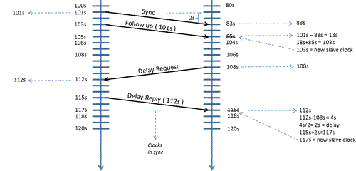
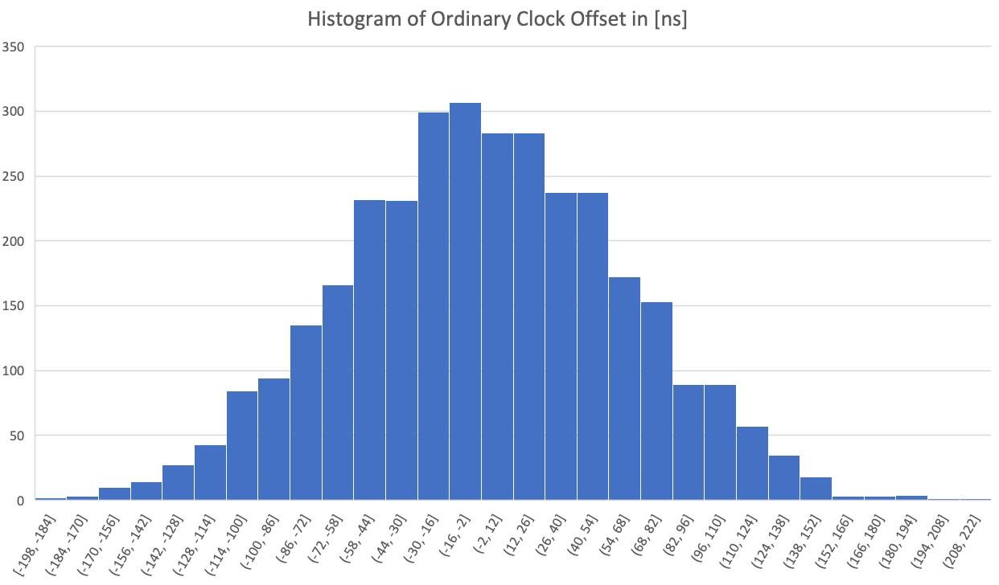
Precision
Precision is based on the sync variance perceived by the end node
End node is performing sync using a servo via the fabric of the network
Past offset changes determine/estimate the precision

Slide 9

Schematic of Time Sync across the Network
NIC
TC
Open Time Server (a.k.a. GM)
TC
TC
TC
TC
TC
TC
Network Fabric
NIC
App
Servo
Oscillator
End node

Slide 10
Law of total variance
NIC
TC
NIC
App
Servo
TC
TC
TC
Open Time Server (a.k.a. GM)
TC
TC
TC
Oscillator
End node
Network Fabric

Slide 11
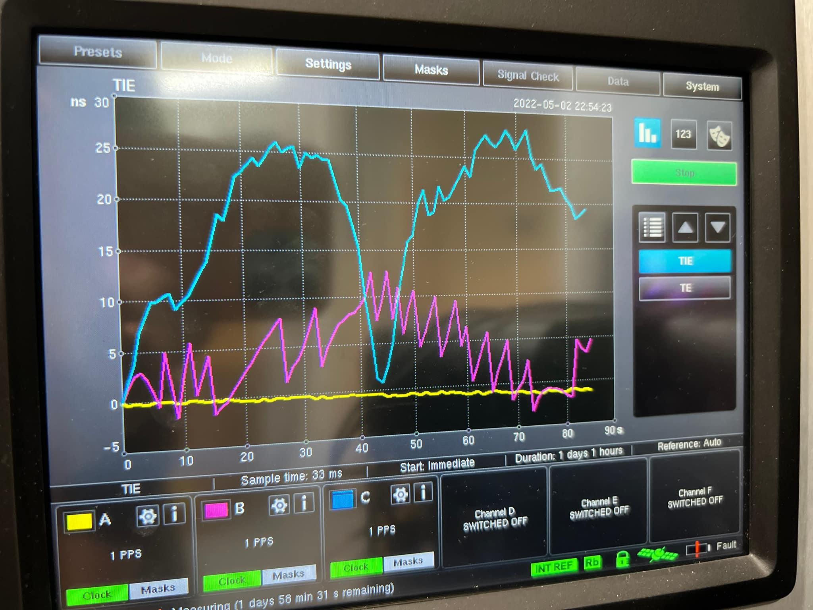
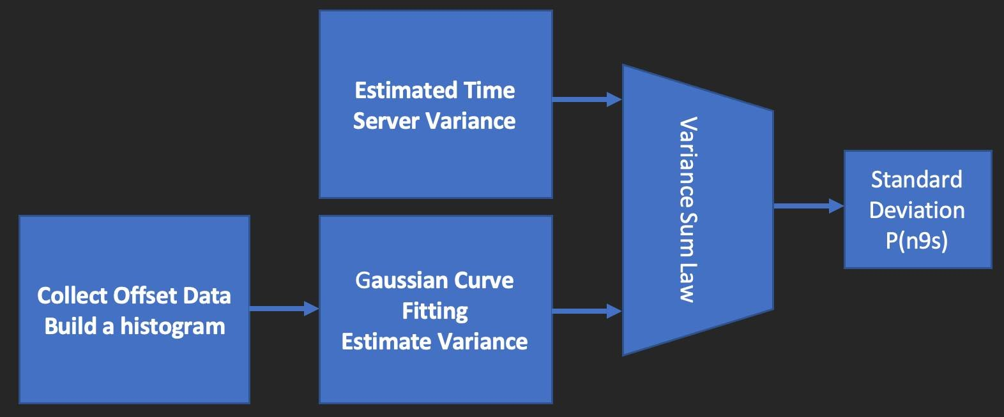
Open Time Server Error Bound
GNSS
MAC
NIC
Open Time Server (a.k.a. GM)

Slide 12
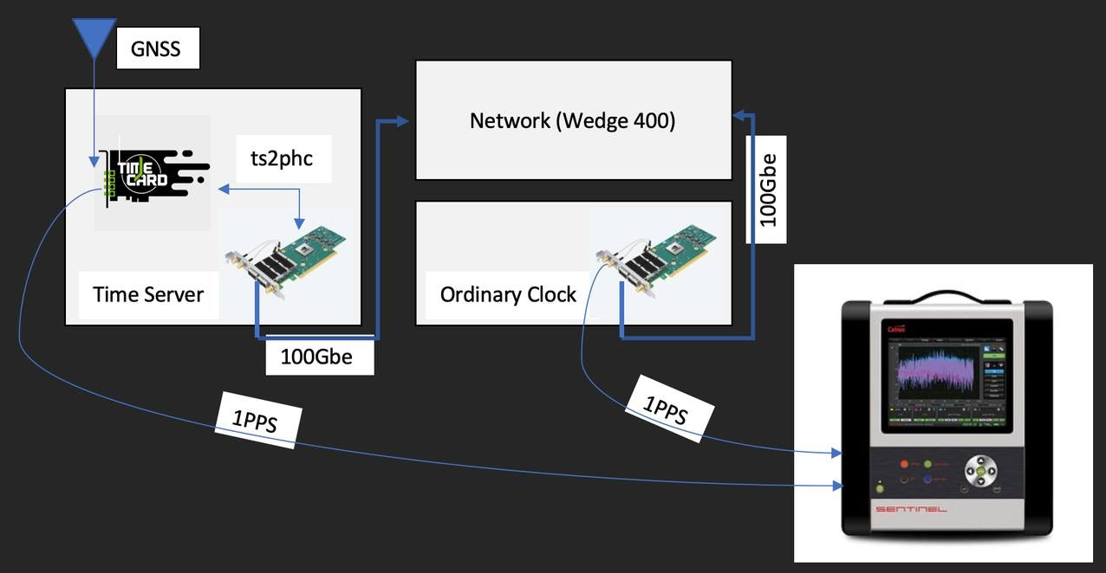

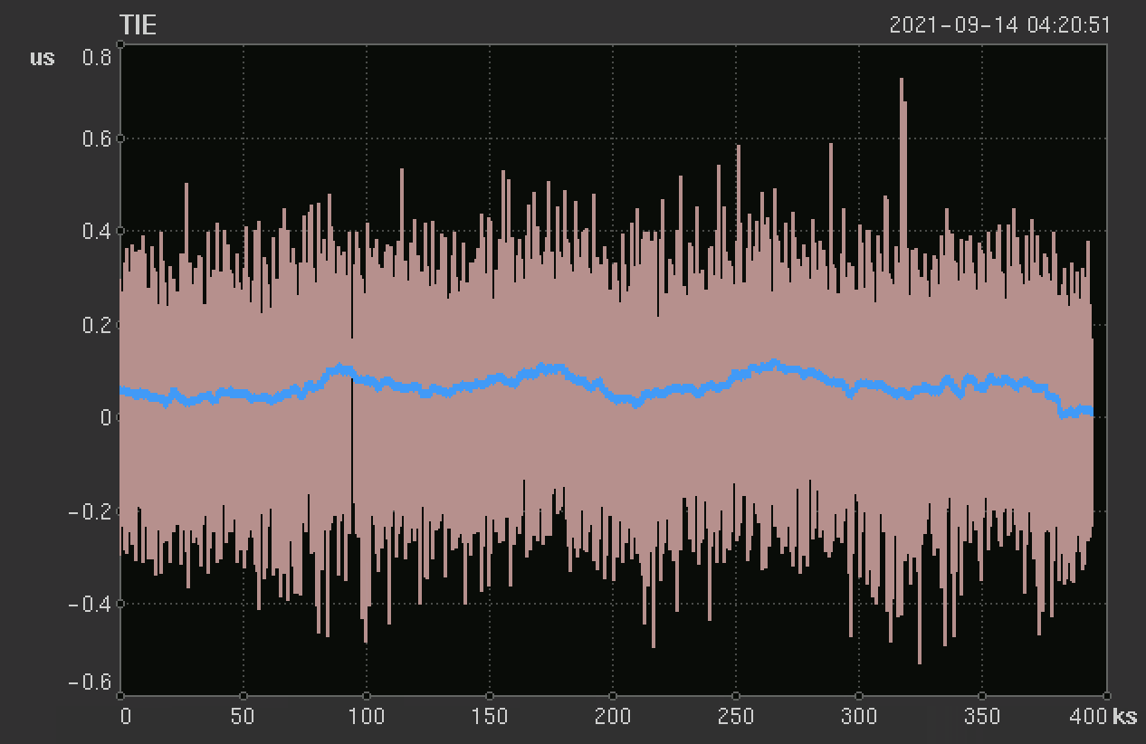
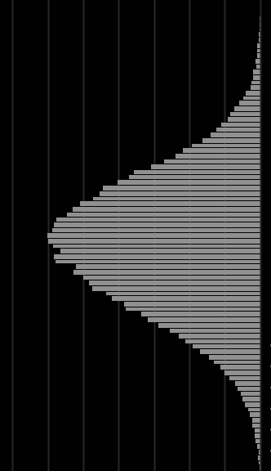
Experiment
Front End NIC
Network (TCs)
End Node
NIC
Ideally!
STD[E2E]≃90ns

Slide 13
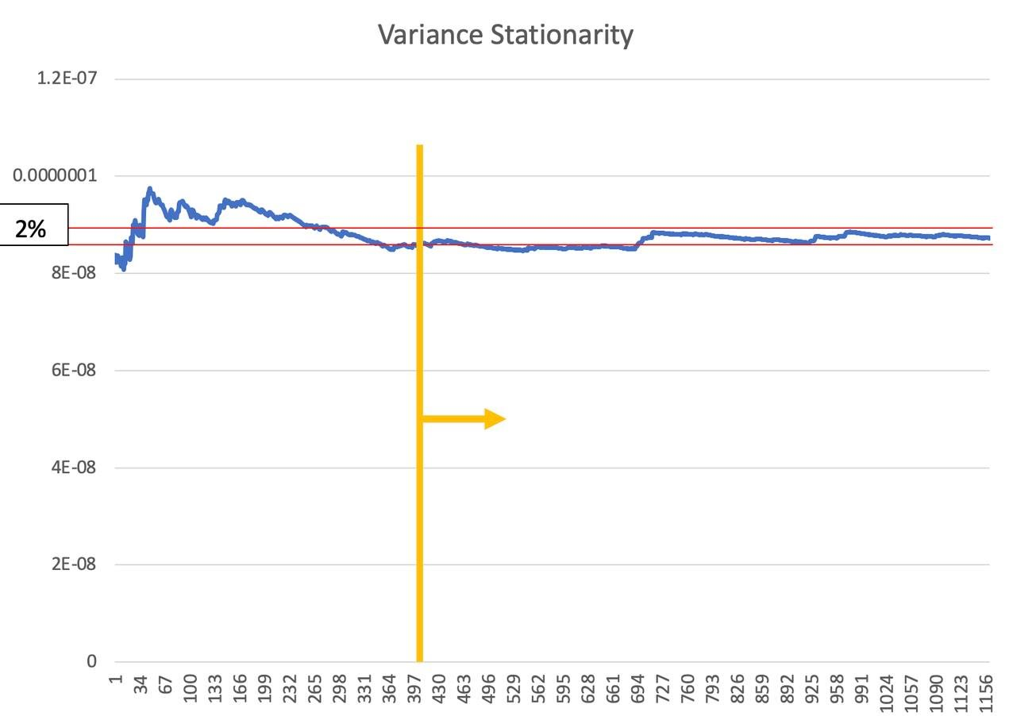
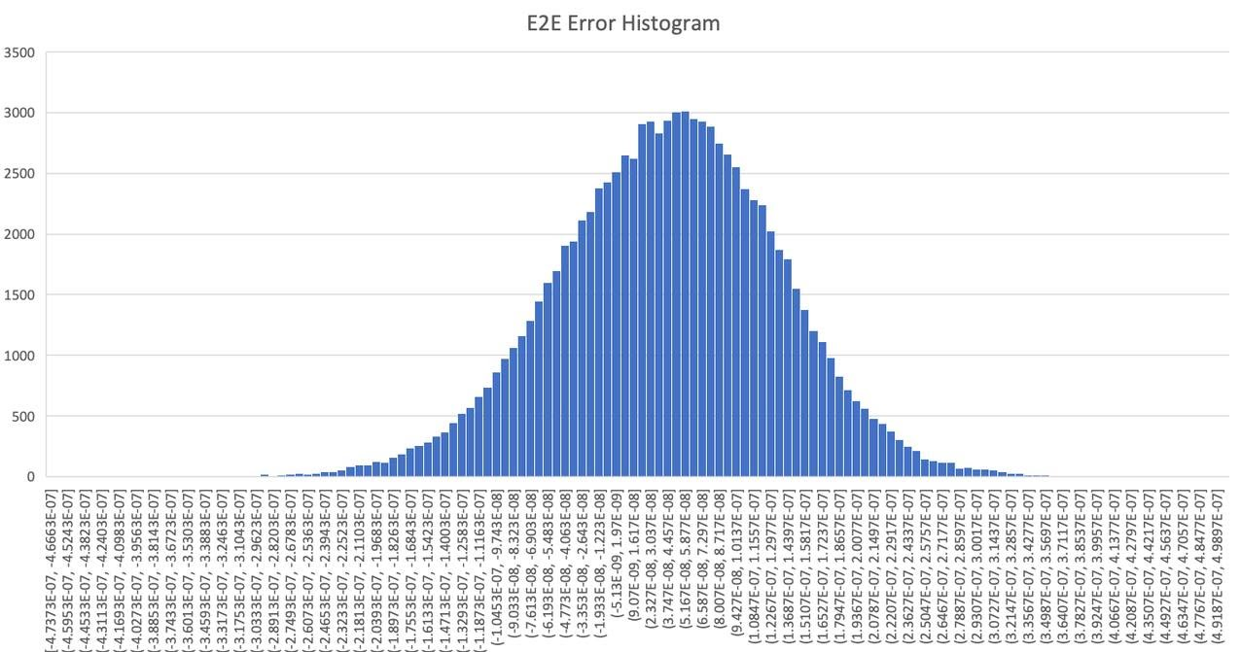
Estimation of Variance and Stationarity

Slide 14
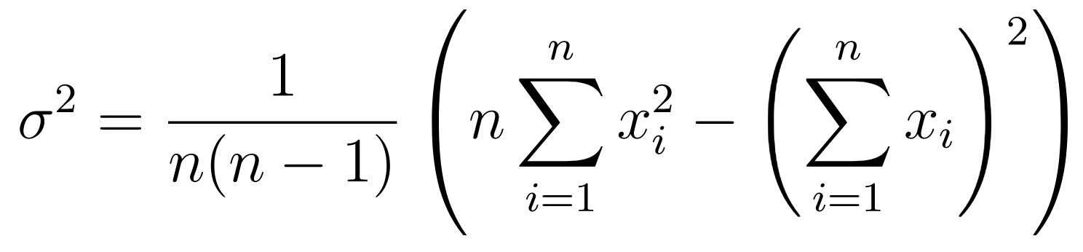
Running Variance
Notes:
Make is symmetric

Slide 15
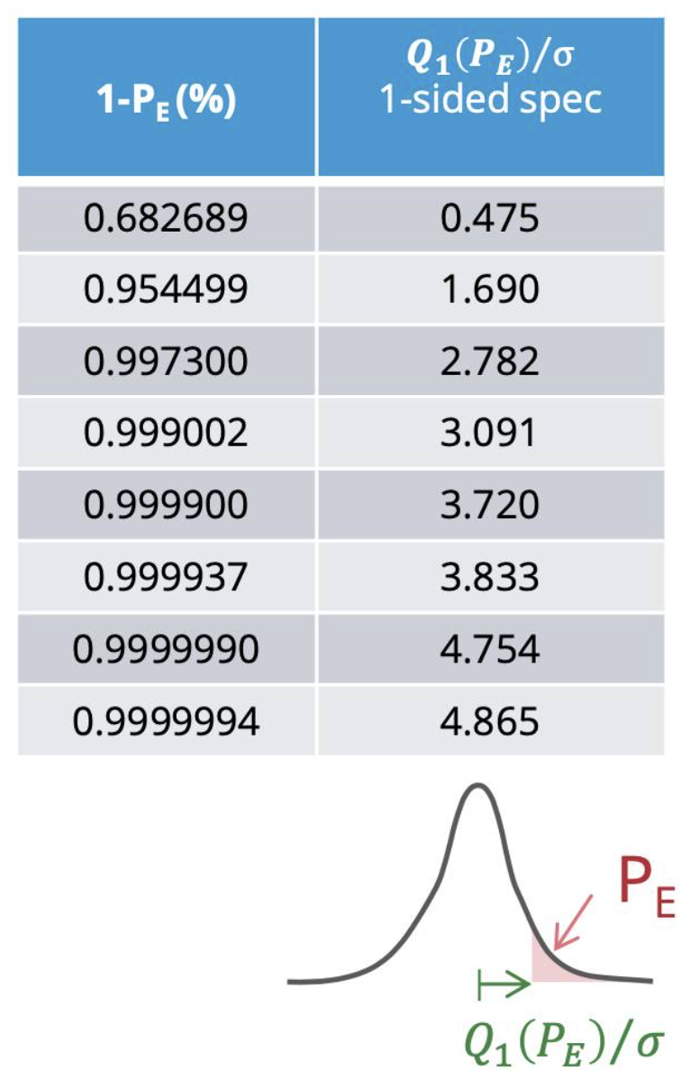
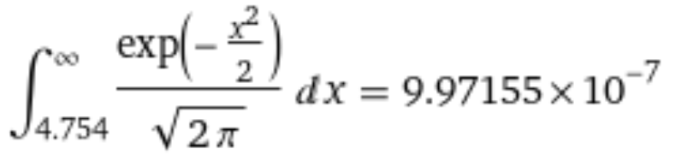
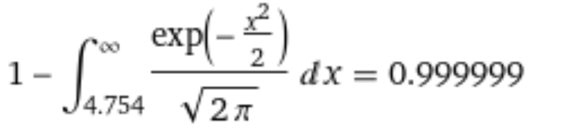
Estimation of error bound (WOU)

Slide 16
Temperature Aware Error Bound
Monitor frequency adjust versus present oscillator temperature
Monitor temperature changes
Estimate upcoming changes of frequency based on temperature changes
Adjust the ratio between relying on existing model vs observation
Model in this case is the hold over
Observation in this case is a single clock sync episode

Slide 17
Estimation of Accuracy
Reference
Not Accurate
Not Precise
Accurate
Not Precise
Not Accurate
Precise
Accurate
Precise

Slide 18
Estimation of Accuracy
Based on Linearizability test
Estimation of statistical specificity
How specific is it to find a machine that is not linearizable
This method is optimized for a TC only implementation
Can be extended to BC included implementations
Each node seeks feedback from a random peer
Decentralized
A scrolling history of linearizability tests with random peers determines the current estimate of accuracy

Slide 19
Estimation of Accuracy
Time Server
TC
TC
TC
TC
TC
TC
TC
TC
TC
TC
TC
TC
TC
TC
TC
OC
OC
OC
OC
OC
OC

Slide 20
Rogue Transparent Clock
Time Server
Not applying CF
Issues with LO
All the subsequent chain gets affected
TC
TC
TC
TC
TC
TC
TC
TC
TC
TC
TC
TC
TC
TC
TC
OC
OC
OC
OC
OC
OC

Slide 21
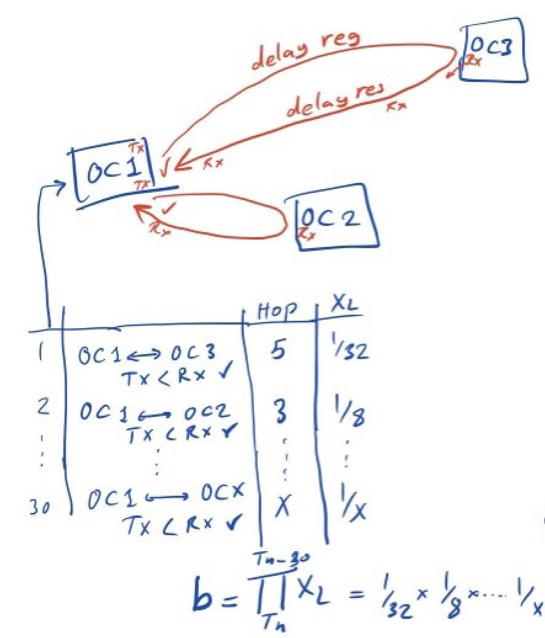
Accuracy Scenarios

Slide 22
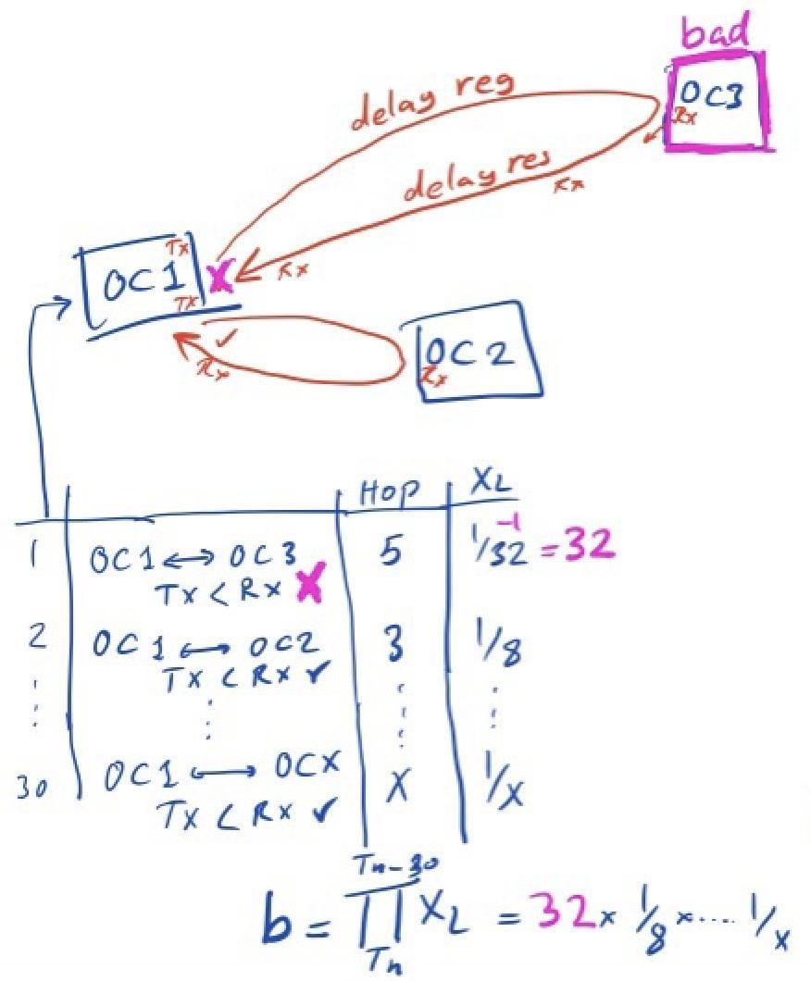
Accuracy Scenarios

Slide 23
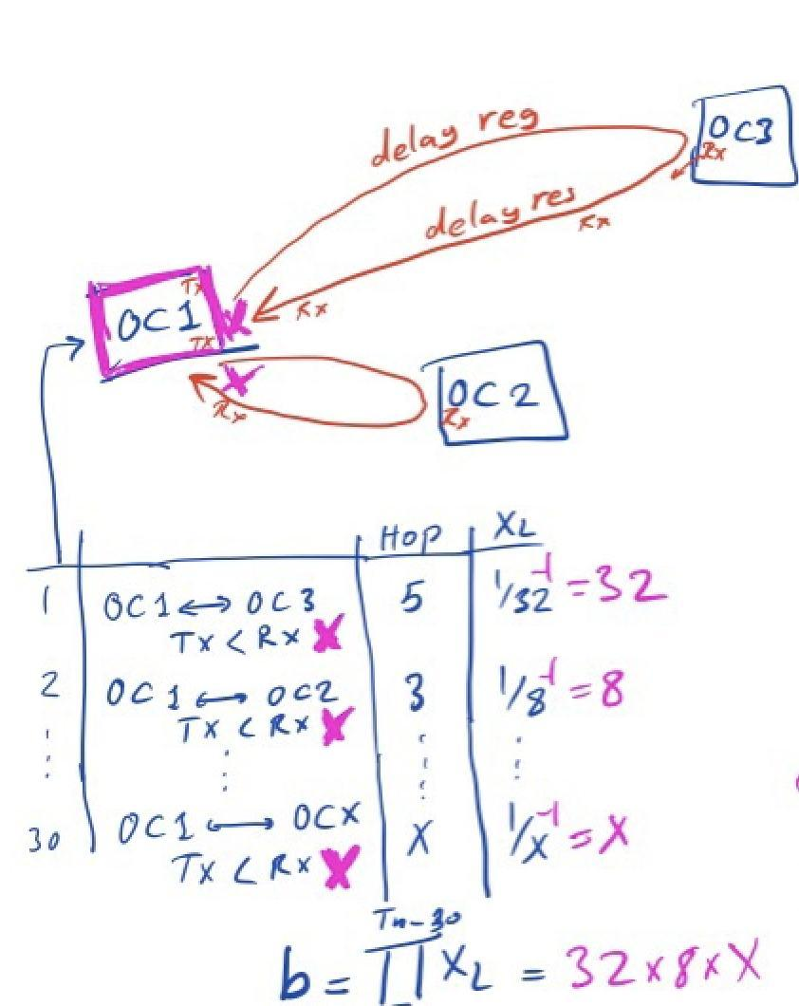
Accuracy Scenarios

Slide 24
Conclusion
Time Sync Error Bound is an estimation process
The current state is determined by scrolling over the past observations
Sensory information like temperature monitoring can improve the estimation
Precision and Accuracy should be identified and calculated separately

Slide 25
Questions?

